Slide 1


Slide 2
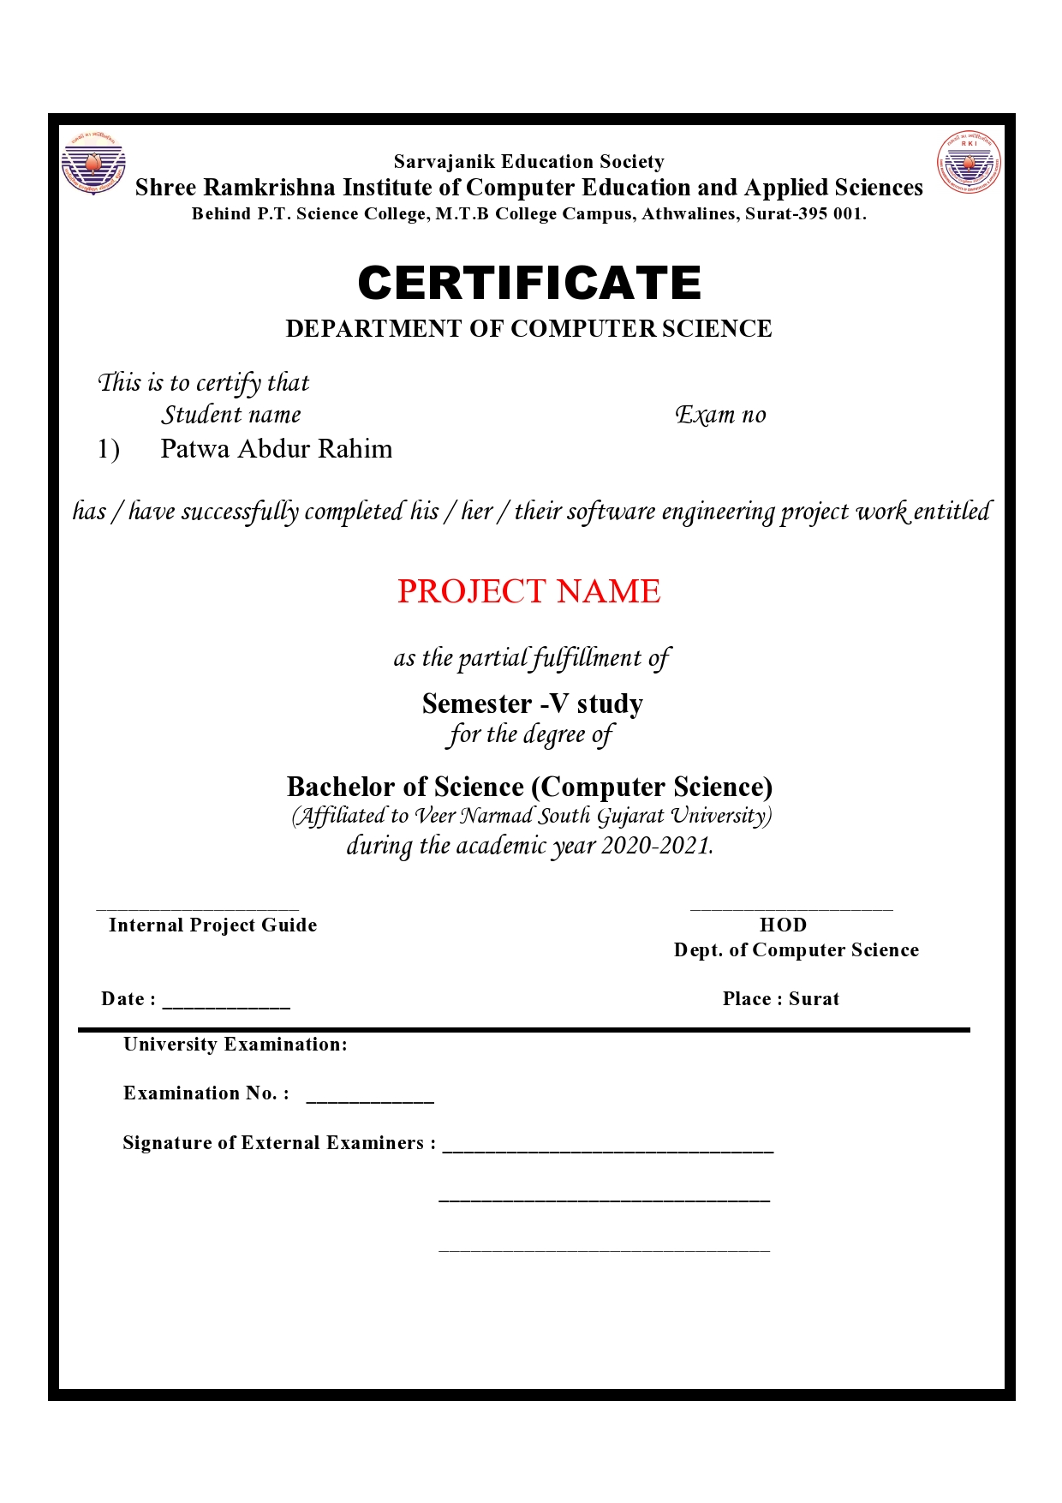

Slide 3
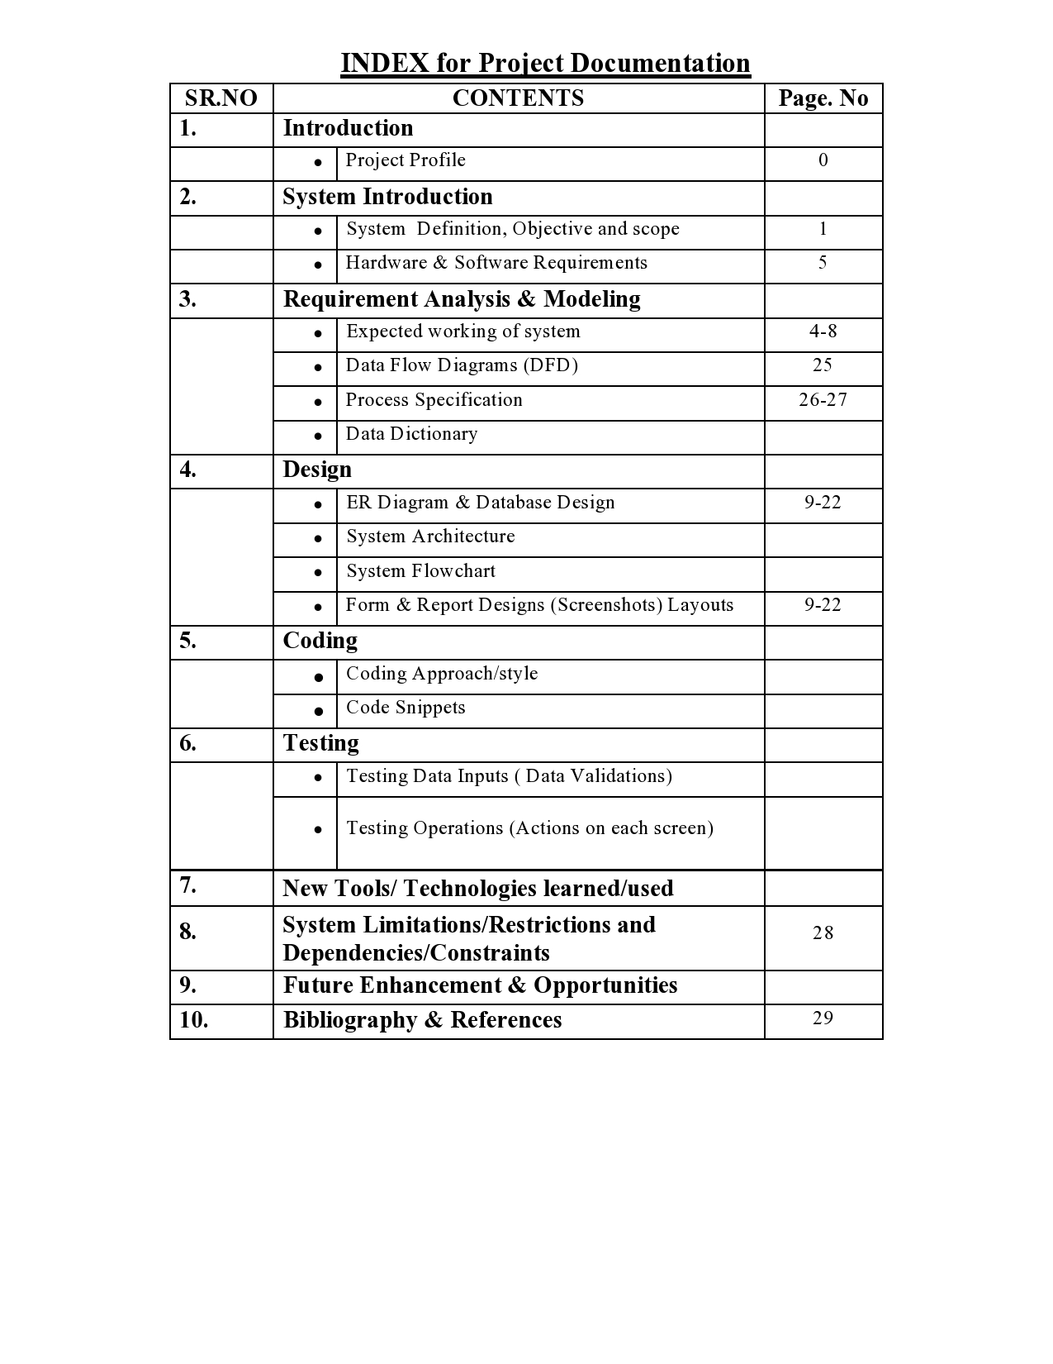

Slide 4
Medical Store Project
Name:- Patwa Abdur Rahim
Class:- Ty Bsc cs Sem 5 Div B
Subject:-505 PHP Programming
Project Topic:- Medical Store (Online Medical Products Selling)
Enrollment No.:- E18111920003175
Project Guide:- Shweta Mam
Developed by:- Patwa Abdur Rahim

Slide 5
System Introduction:-
The Medical store system software used in medicalstore. Medical Store System’s
purpose is to tell customer which and what kind of Medicines & Prducts are
available at Medical store. This System makes business fast , more convenient
and reliable. As we know that all dynamic website or software needs database,
Here in this medical store system project I’ve used mysql database.
There are two major part of this system :- Administration Panel & Frontend.
The Administration Panel (or the admin panel for short) is the primary tool for admin
(Medical Store Owner) to manage business online. From administration panel admin
Can manage Products , Product Categories (Kind of product) , Users , Website
Currency , Orders & Admin Profile.
discounts, interact with your customers, change the look of your store and do much more.
Languages used in system:-
Back end:- PHP , Mysql , Html , Javascript (Jquery) , Css
Frontend:- PHP , Mysql , Html , Javascript (Jquery) , Css
SRICEAS 1 Medical Store Project

Slide 6
System Advantages:-
Advantages of making Online Medical Store:-
Medicines are one of the important factors that are necessary to cure a person’s
Disease. When Person is not able to come to store to purchase medicine or for
Some reason reaching to medical store is not convenient or possible , in this
case online medical store makes it possible. User just have to order his product
On website. Admin (Who manages Administration Dashboard) receives order and
Delivers it in promised time.
Convenience :- Convenience is the main advantage of buying medical products
online For those who lead busy lifestyles and simply do not have the time in the
day to visit medical store. Being able to order prescription medicine from the
comfort of your own home is certainly a better option.
SRICEAS 2 MEDICAL STORE

Slide 7
System Advantages
Discretion :- Have you ever been faced with the task of buying medication that
may be the cause of embarrassment? It happens to the best of us and isn’t
usually a pleasant experience. Sometimes discretion is best so if you need to
purchase something along the lines perhaps a haemorrhoid treatment or
something for which you feel awkwardness asking for , wouldn’t you prefer to do
this online instead of in a shop full of prying eyes? Nobody need ever know and so
long as you ensure you receive the package yourself, they never will.
SRICEAS 3 MEDICAL STORE

Slide 8
System software use:-
This system contains two main module:- 1.Admin Panel(Dashboard) , 2.Frontend(For customers.)
Admin Panel (Administration Dashboard) is only accessible for authorized person.
From Admin Panel admin handles his online store. There are functionality of every
possibility is included to manage store online. From admin panel admin can
manage store’s product and products categories. Admin can make product
available or unavailable on store(frontend). Orders are received at admin
dashboard. Admin can deal with orders very easily like change order , delete
delievered order and more. Admin also can manage customers identity online
and user registration. Admin can also manipulate website minor details of store
like store currency. System software makes it easy and less timewasting.
SRICEAS 4 MEDICAL STORE

Slide 9
Hardware and software requirements
Frontend of Medical store system is an software application for medical shop
designed as to ease the work load of medical shop professionals. The main
feature includes Billing, Shopping, Orders, Product Information, purchase
report and customer details, etc.
Software Requirement:-
Backend:- localhost (Xampp/Wampp)
Frontend:- Sublime Text
Hardware Requirements:-
Memory:- 77.8 MB
Hard disk space:- 2GB
SRICEAS 5 MEDICAL STORE

Slide 10
System modules:-
System modules
Admin Panel (Administration Dashboard)modules:-
Expected of working admin panel
Admin Login
Category management
Product management
Orders management
User management
Global Settings
Admin Profile
Admin Login:- Admin login module is for admin access and authoriation. It checks
Whether authorized person is accessing Administration Dashoard or not.
SRICEAS 6 MEDICAL STORE

Slide 11
System modules
Category Managemet:- Category management is made for handling product
categories operations like insert , update , delete , sorting , status , searching &
pagination.
Product Managemet:- Product management is made for handling product
operations like insert , update , delete , sorting , status ,searching &
pagination.
Order Managemet:- Order management is made for handling order
operations like insert , update , delete , sorting , status , searching &
pagination. Specific order for particular can be managed by.
User friendly & Responsive UI designed for Administrator’s convenience.
SRICEAS 7 MEDICAL STORE

Slide 12
System modules
User Managemet:- All those user who sign up to our store from fontend are r
registered here. From user management table users can be deleted ,
disabled , sorted & searched.
Website Global Settings:- This feature is provided to change store currency from
Dashboard. In case owner decides to expand business like multi-national
business then just have to choose new currency from dropdown.
Admin Profile:- Feature is included for changing admin login credentials.
SRICEAS 8 MEDICAL STORE

Slide 13
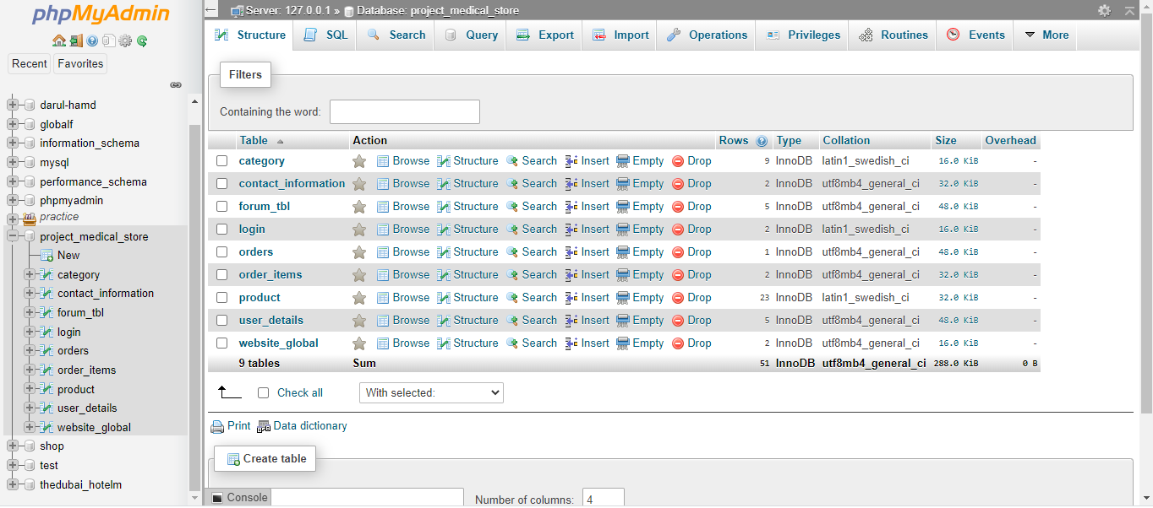
Database screenshot
Database Screenshots:-
SRICEAS 9 MEDICAL STORE

Slide 14
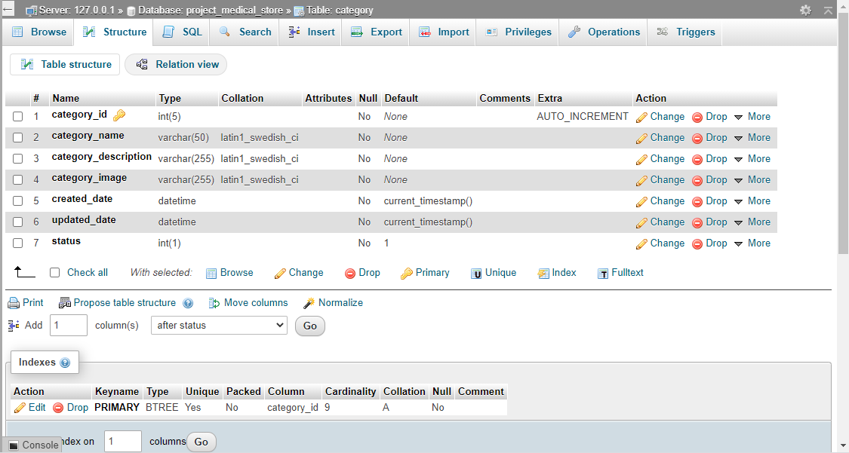
Database screenshot
SRICEAS 10 MEDICAL STORE

Slide 15
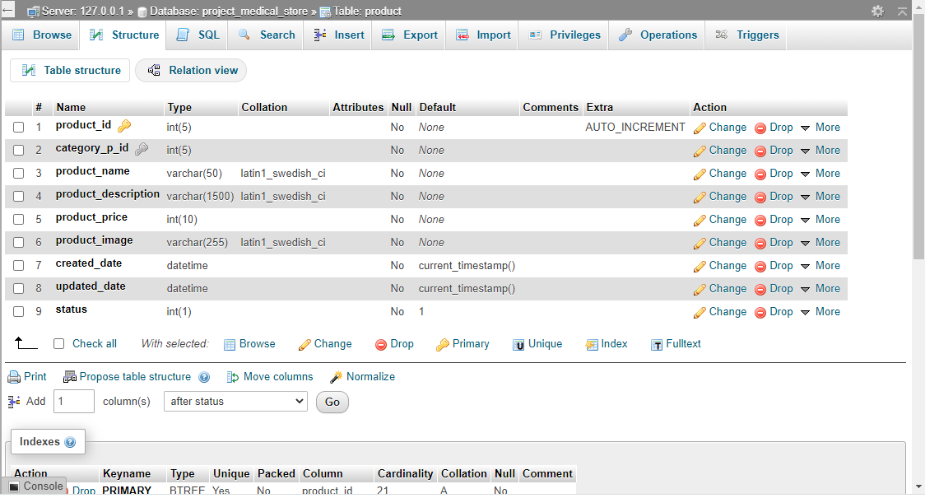
Database screenshot
SRICEAS 11 MEDICAL STORE

Slide 16
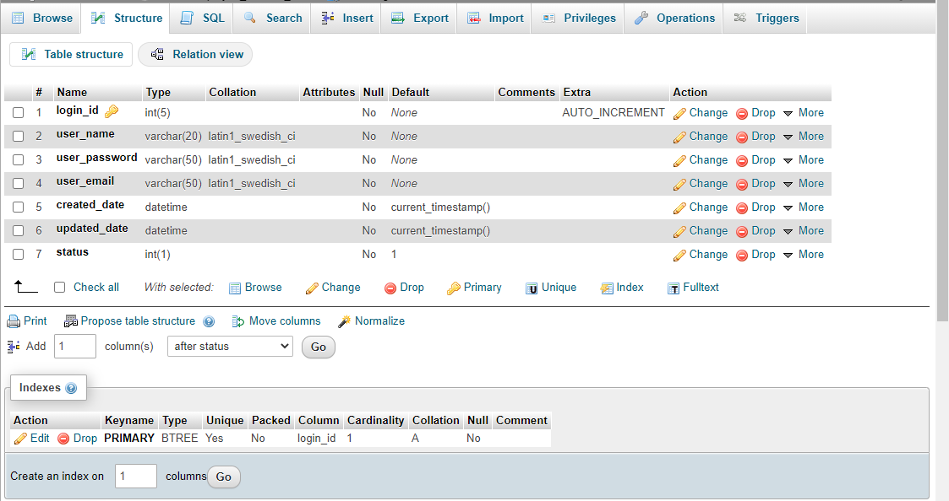
Database screenshot
SRICEAS 12 MEDICAL STORE

Slide 17
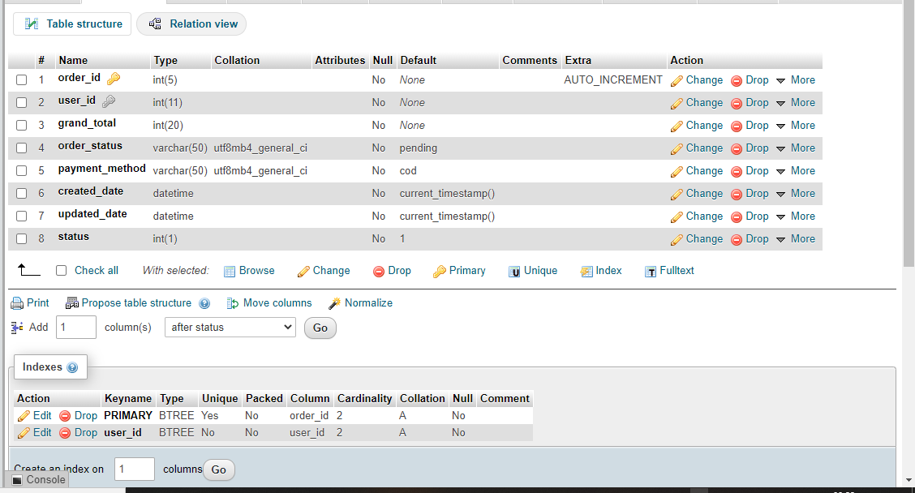
Database screenshot
SRICEAS 13 MEDICAL STORE

Slide 18
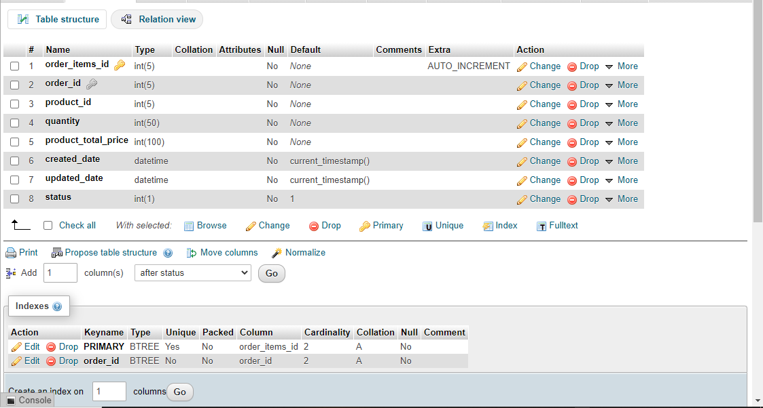
Database screenshot
SRICEAS 14 MEDICAL STORE

Slide 19
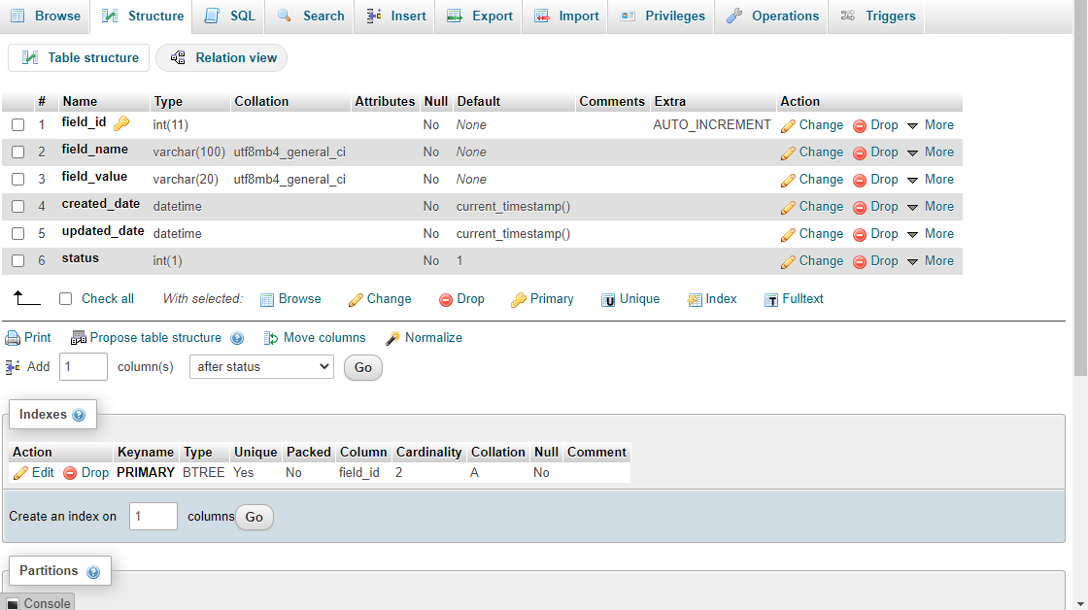
Database screenshot
SRICEAS 15 MEDICAL STORE

Slide 20
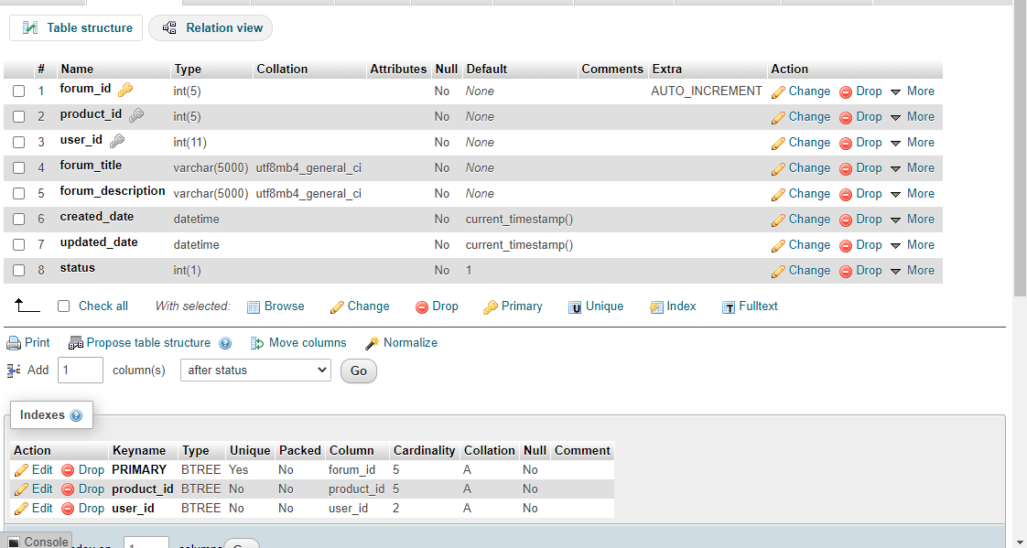
Database screenshot
SRICEAS 16 MEDICAL STORE

Slide 21
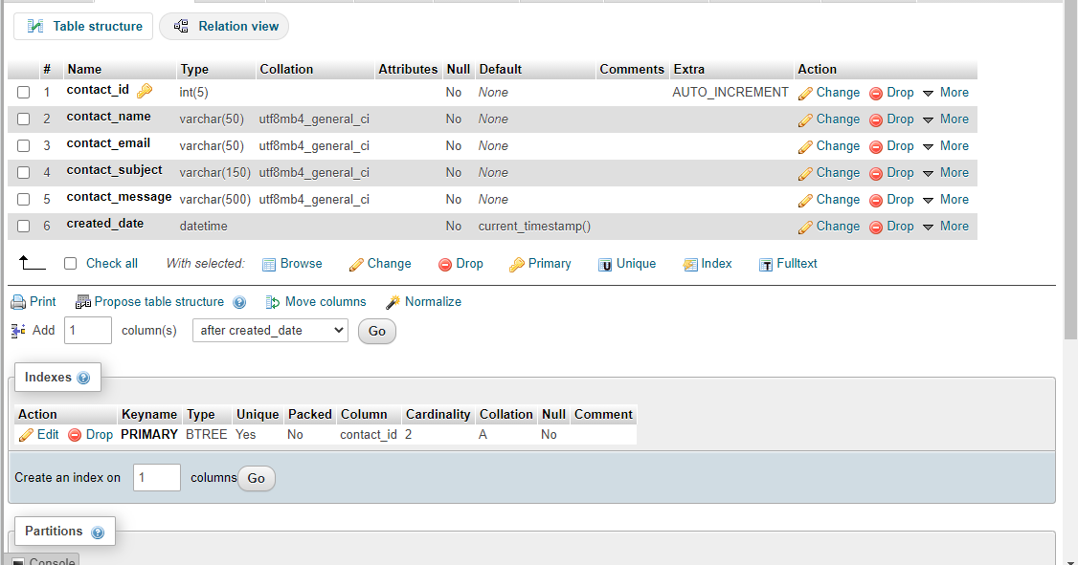
Database screenshot
SRICEAS 17 MEDICAL STORE

Slide 22
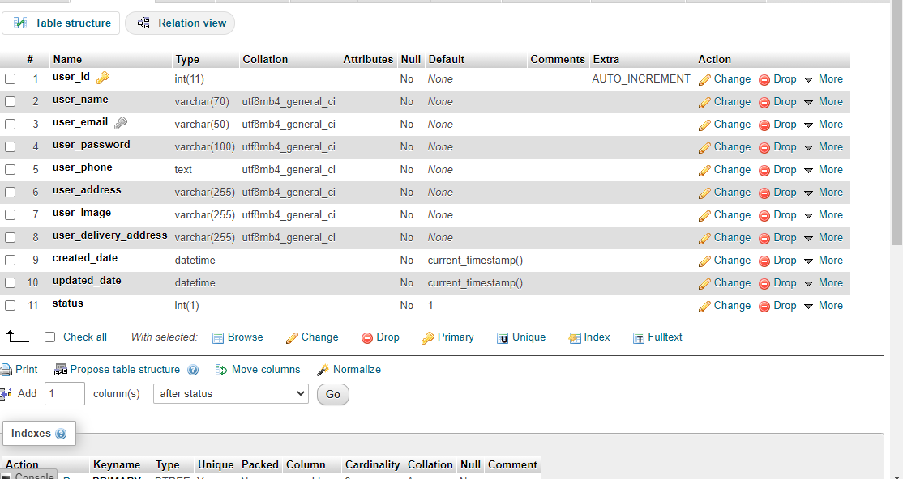
Database screenshot
SRICEAS 18 MEDICAL STORE

Slide 23
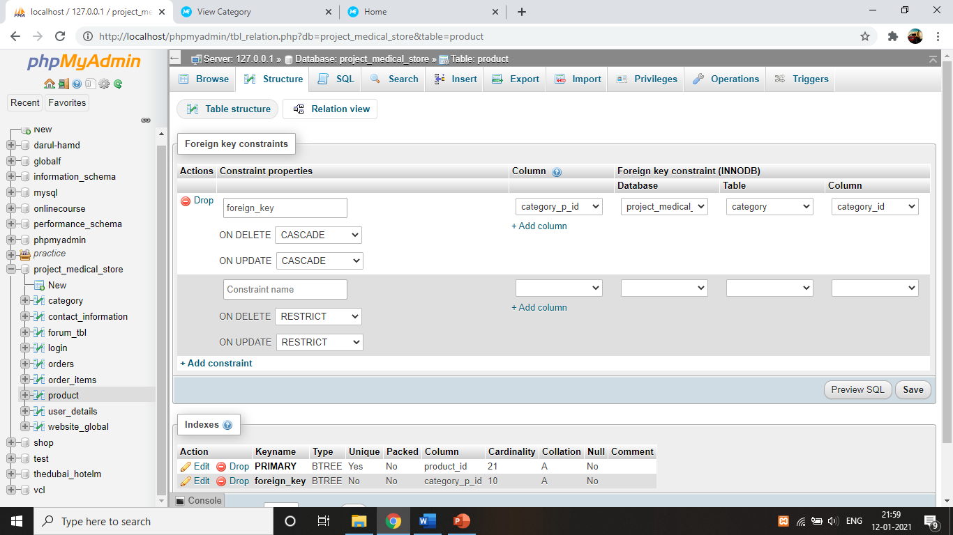
Database screenshot
SRICEAS 19 MEDICAL STORE

Slide 24
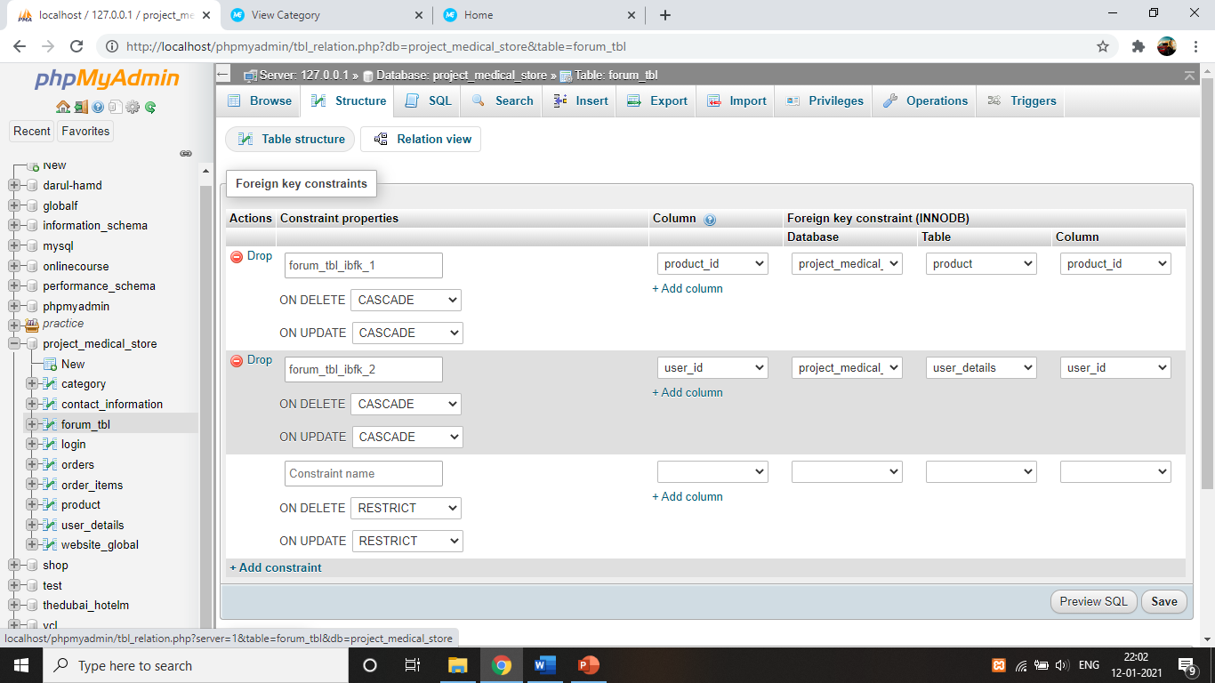
Database screenshot
SRICEAS 20 MEDICAL STORE

Slide 25

Database screenshot
SRICEAS 21 MEDICAL STORE

Slide 26
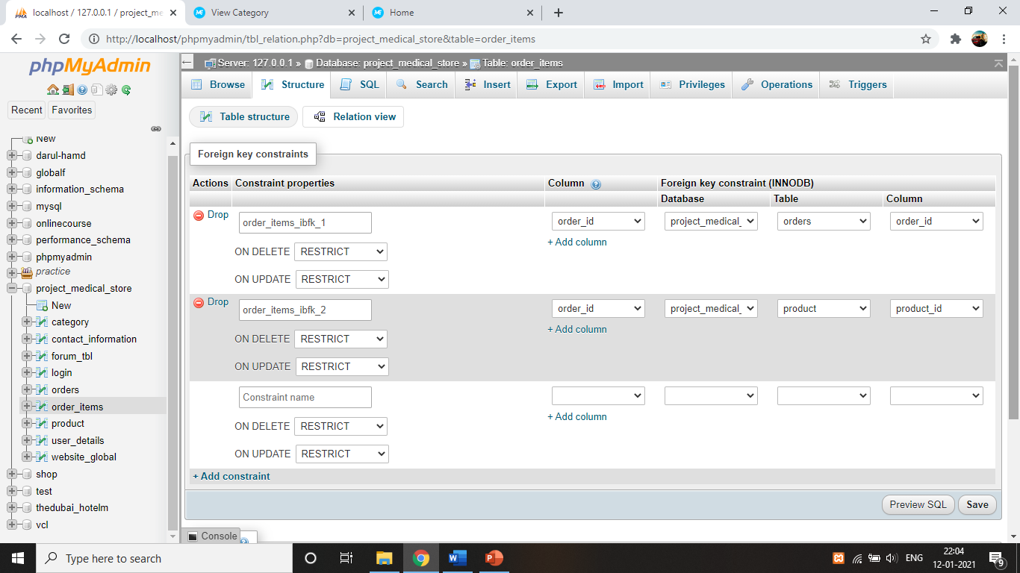
Database screenshot
SRICEAS 22 MEDICAL STORE

Slide 27
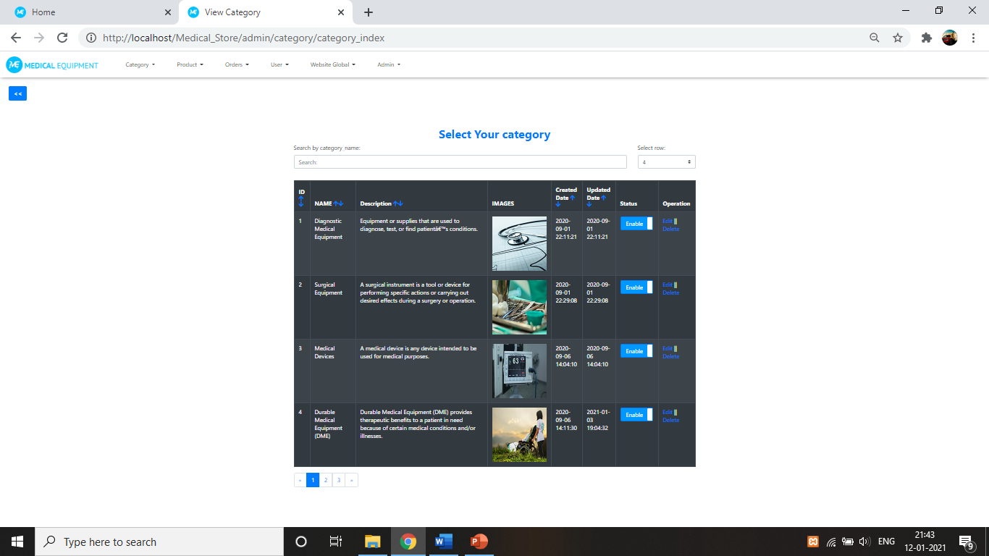
Admin site features
SRICEAS 23 MEDICAL STORE

Slide 28
Admin site features
Datatables :- Category , Product , Orders , User .
Category and Product tables are linked through Foreign Key Relationship. Category table holds information of kind of(category of product).
Admin site Modules features:- Insert Data , Update Data , Delete Data , Data Sorting ,
Data Searching , Data pagination.
Frontend site Module features:- Shopping Cart process (through ajax) , Sign-in
& User Registration , Order Products feature , Products filtering by category ,
Checkout Feature , Forum Discussion(Registered User can make discussion)
SRICEAS 24 MEDICAL STORE

Slide 29
DFD (0 level)
DFD 0 LEVEL
Category Management
Purchase Product
Product Management
Shop Details
Orders Management
User Registration
Online Medical Store System
Administration
Frontend (User Interface)
User Management
Cart System
Checkout
Website Global Seeting
Discussion Forum
Admin Profile
Shop Page(Categorize products)

Slide 30
DFD (1st level) Admin Panel:-
Manage Category
Login to Admin Panel
Admin
Manage Products
Order Management
Give Access If Credentials matches
Crud Operations ,
Sorting , Searching , Pagination
User Management
Manage Administration
Modules
Website Global Settings
Admin Profile Management
Change Store Currency
Edit Profile , Logout

Slide 31
DFD (1st level) Frontend:-
Login to store
Frontend
Add to Cart
View Discussion
About Us & Contact Us
User Registration
Home Page
Shop Page (Categorize product)
Login to Process Next
Proceed to checkout
Order Online
Join Discussion
Edit Profile
My account Page

Slide 32
Limitations:- Since this is a huge project to take care of I had to cut back on some of the basic requirements of the sites. Still have to work on Administration Design. Admin panel is not much as responsive as needed. Payment method integration is still left.
Limitations
SRICEAS 28 MEDICAL STORE

Slide 33
Bibliography & References:- - www.google.com - www.w3schools.com
Bibliography & References
SRICEAS 29 MEDICAL STORE

